Slide 1
Natural Language Processing

Slide 2
Good evening, everyone. Welcome to the live session.
Today, we will be practicing problems from the current week’s content.
We will wait 5 minutes for everyone to join in and start at 7:05 pm.
Learn more

Slide 3
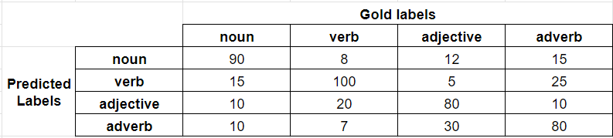
Suppose you have trained a classifier for part-of-speech tagging. Consider the confusion matrix shown below.

Slide 4
Question 1: Calculate the following:
a. macro averaged precision
b. macro averaged recall
c. accuracy
d. micro averaged precision
e. micro averaged recall

Slide 5
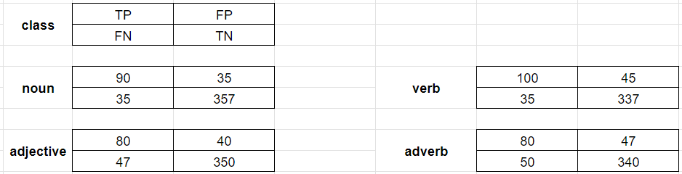
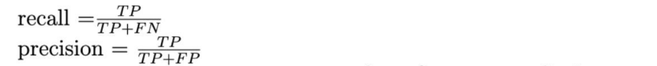
Solution
Separate confusion matrix for each class is as follows:
macro averaged precision = (90/125 + 100/145 + 80/120 + 80/127) /4 = 0.676
macro averaged recall = (90/125 + 100/135 + 80/127 + 80/130)/4 = 0.676

Slide 6
Solution
accuracy = 350/517 = 0.677

Slide 7
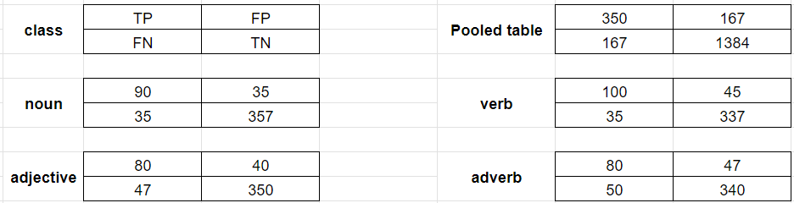
Solution
For micro averaged results, create pooled confusion matrix for all the classes.
micro averaged precision = 350/517 = 0.677
micro averaged recall = 350/517 = 0.677

Slide 8
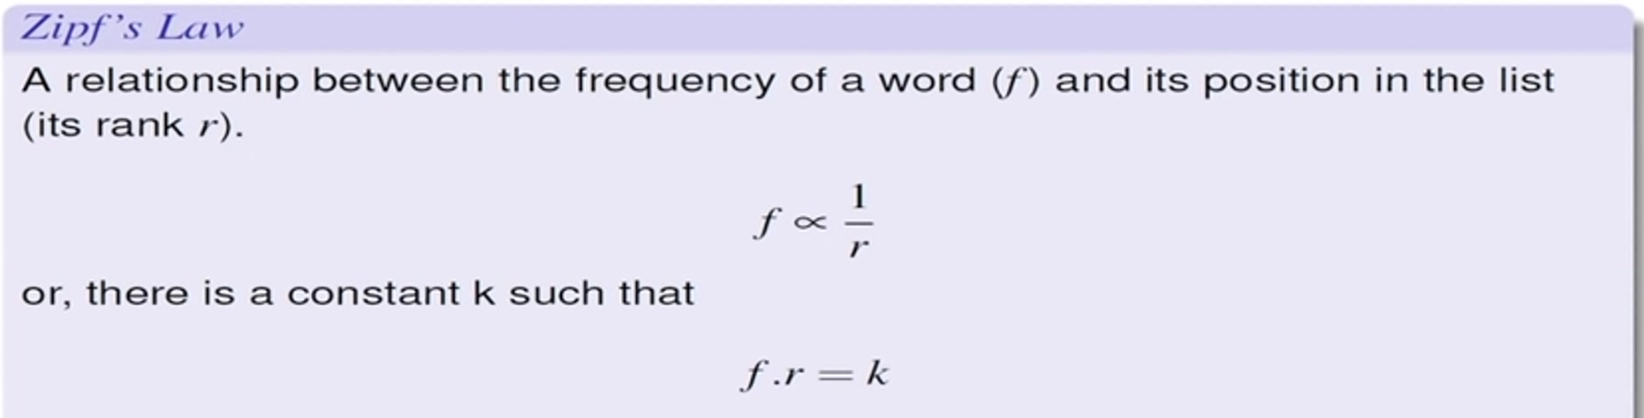
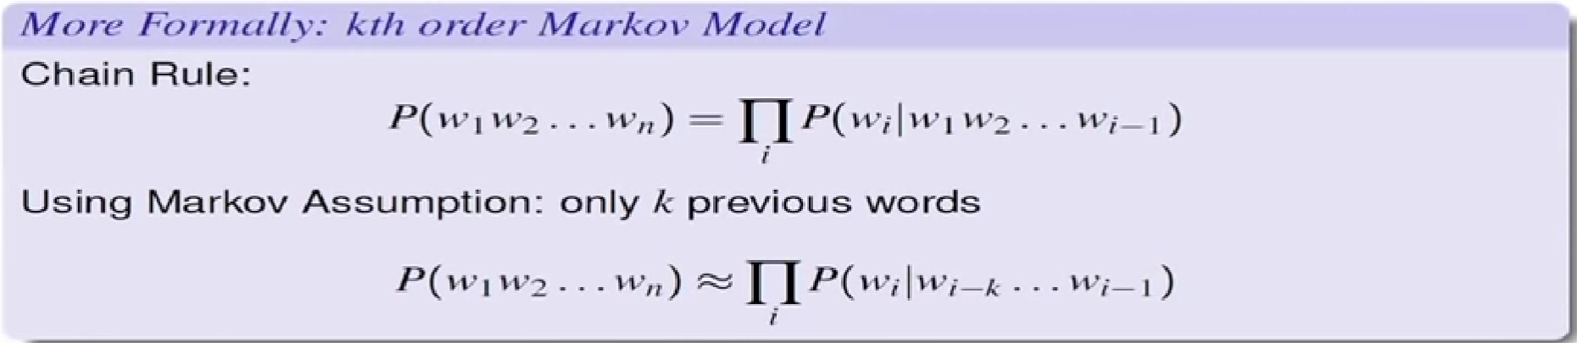
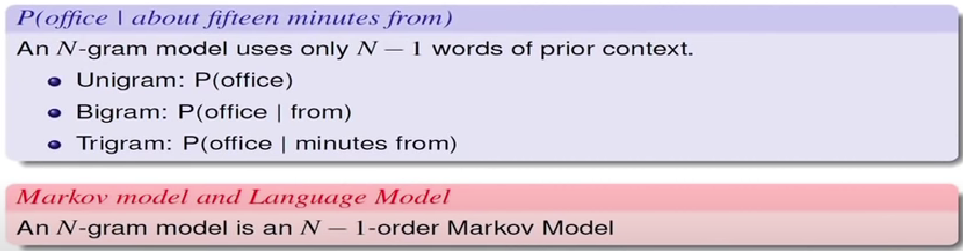

Slide 9
Question 2: Consider the CFG given below:
S → aSb|D
D → Dc|ε
How many non-terminals should be added to convert the CFG into CNF?
A) 3
B) 2
C) 4
D) 5

Slide 10
Solution
Answer: D
Solution: Given: S → aSb|D, D → Dc|ε
Since the start symbol S occurs on the right side of a production rule, we create a new start symbol S’ and a new production rule S’ → S.
S’ → S, S → aSb|D, D → Dc|ε
Remove the null productions: D → ε, S → ε
After removing D → ε: S’ → S, S → aSb|D|ε, D → Dc|c
After removing S → ε: S’ → S, S → aSb|D|ab, D → Dc|c
Remove the unit productions: S → D, S’ → S
After removing S → D: S’ → S, S → aSb|ab|Dc|c, D → Dc|c
After removing S’ → S: S’ → aSb|ab|Dc|c, S → aSb|ab|Dc|c, D → Dc|c

Slide 11
Solution
S’ → aSb|ab|Dc|c, S → aSb|ab|Dc|c, D → Dc|c
4. Since the right-side of the production rules contain both terminal and non-terminal, we add the following rules: A → a, B → b, C → c
S’ → ASB|AB|DC|c, S → ASB|AB|DC|c, D → DC|c, A → a, B → b, C → c
5. Handling the cases where there are more than two non-terminals on the right-hand side by adding the rule E → SB:
S′ → AE|AB|DC|c, S → AE|AB|DC|c, E → SB, D → DC|c, A → a, B → b, C → c

Slide 12
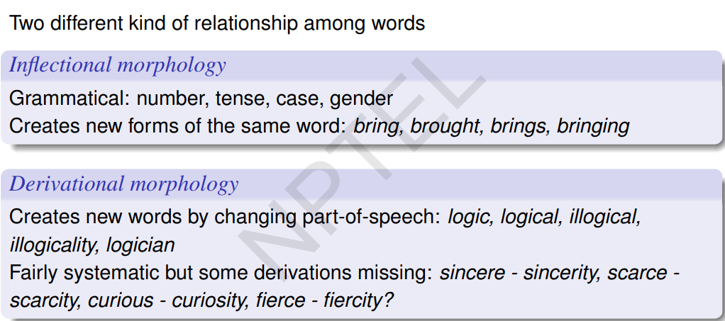

Slide 13
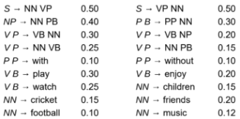

Slide 14
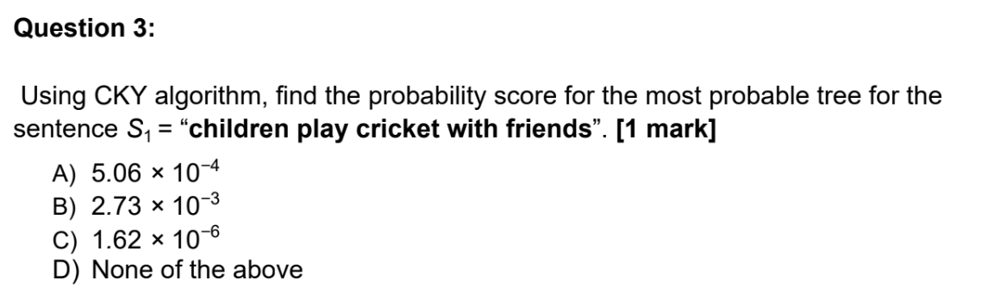

Slide 15
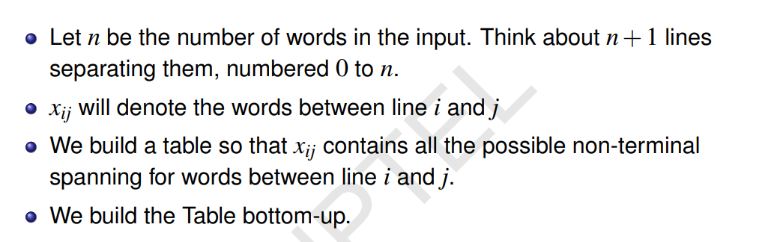
Solution

Slide 16
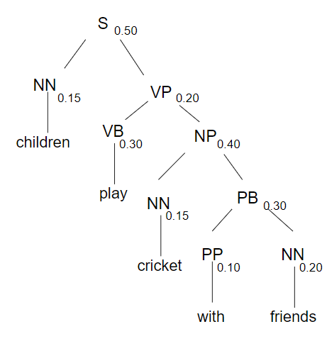
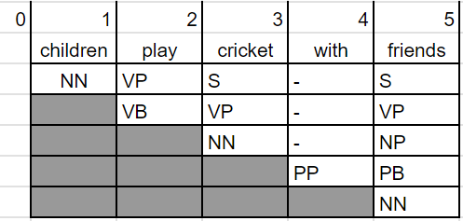
Solution
Answer: C
Solution:

Slide 17
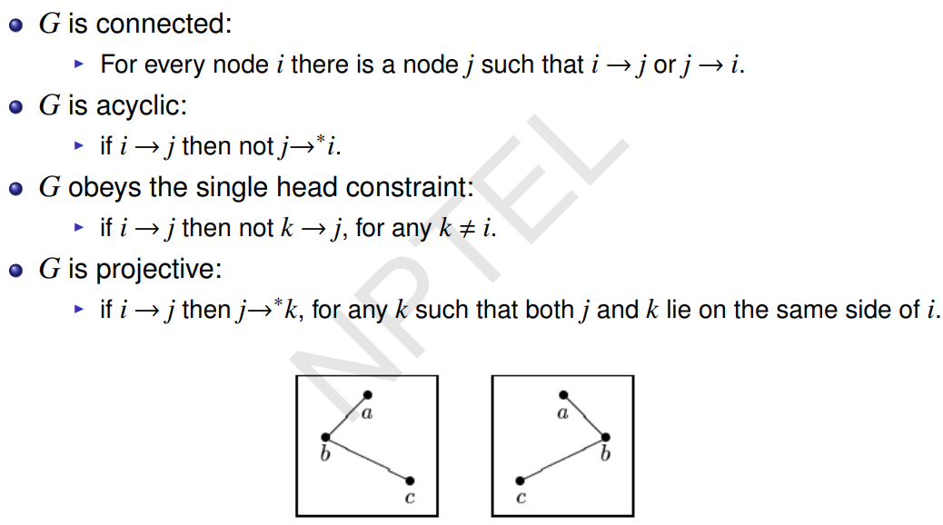
Formal conditions on Dependency Graphs

Slide 18
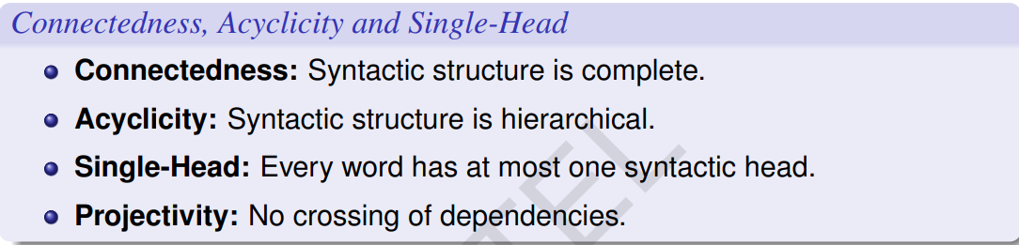
Formal conditions on Dependency Graphs

Slide 19
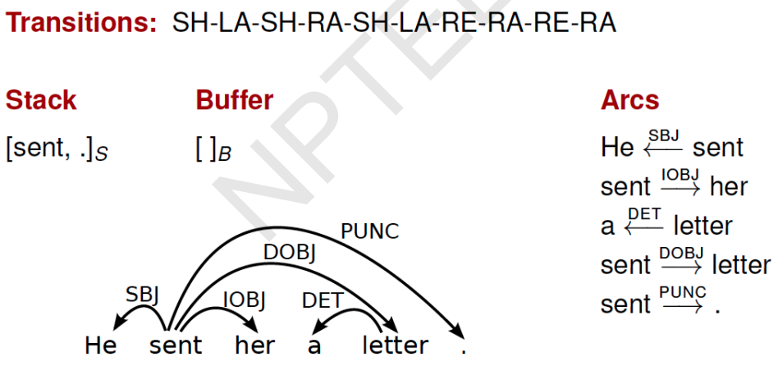
Transition-Based Parsing

Slide 20
Assume that you are learning a classifier for the data-driven deterministic parsing and the sentence ‘I prefer ChatGPT course’ is a gold-standard parse in your training data. You are also given that ‘ChatGPT’ and ‘course’ are ‘Nouns’, ‘I’ is a ‘Pronoun’ while the POS tag of ‘prefer’ is ‘Verb’. Obtain the dependency graph for this sentence on your own. Assume that your features correspond to the following conditions:
1. The stack is empty.
2. Top of stack is Noun and Top of buffer is Verb.
3. Top of stack is Pronoun and Top of buffer is Verb.
4. The word at the top of stack occurs before word at the top of the buffer in the sentence
The initial weights of your features are [2,2,2,2 | 3,3,3,2| 2,2,2,2 | 2,2,2,2] where the first four features correspond to LA, and then to RA, SH and RE, respectively. Use this gold standard parse during online learning. What will be the weights after completing two iteration of Arc-Eager parsing over this sentence:

Slide 21
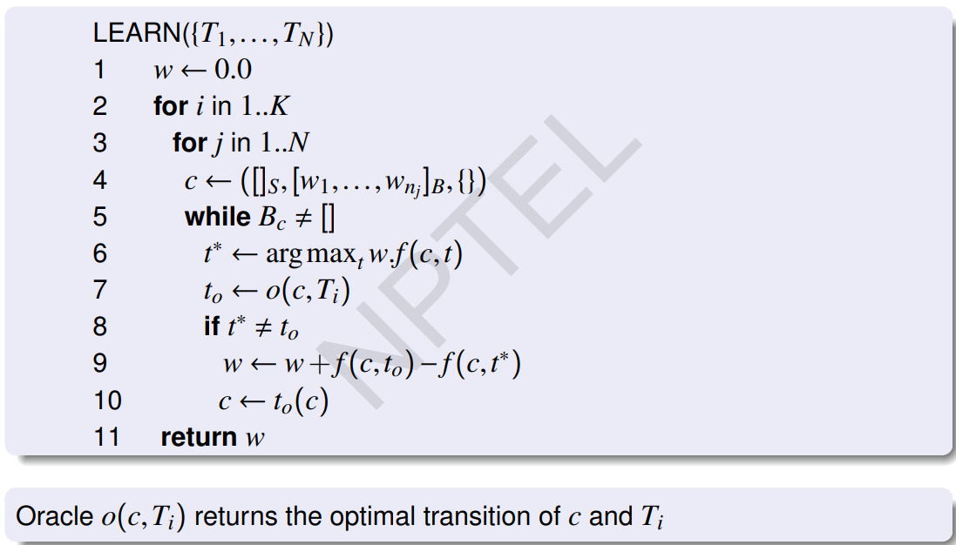

Slide 22
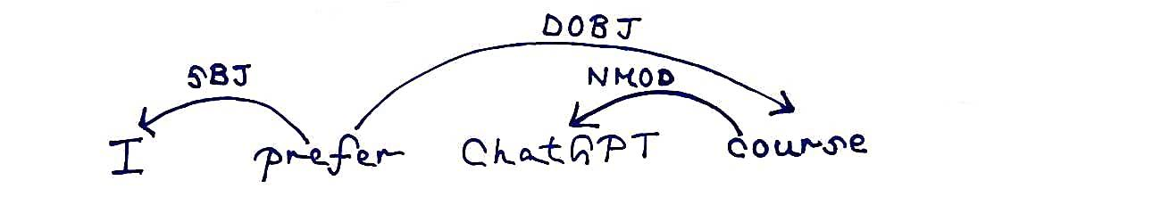
Solution
Given - The first four features correspond to LA, and then to RA, SH and RE, respectively.
f(c,t) = [c₁&&LA, c₂&&LA, c₃&&LA, c₄&&LA | c₁&&RA, c₂&&RA, c₃&&RA, c₄&&RA | c₁&&SH, c₂&&SH, c₃&&SH, c₄&&SH | c₁&&RE, c₂&&RE, c₃&&RE, c₄&&RE]
Initial weight: w = [2,2,2,2 | 3,3,3,2| 2,2,2,2 | 2,2,2,2]

Slide 23
Solution
Current configuration = []_{S}, [I,prefer,ChatGPT,course]_{B}, {}
Conditions: 1. The stack is empty. 2. Top of stack is Noun and Top of buffer is Verb. 3. Top of stack is Pronoun and Top of buffer is Verb. 4. The word at the top of stack occurs before word at the top of the buffer in the sentence.
f(c,t) = [c₁&&LA, c₂&&LA, c₃&&LA, c₄&&LA | c₁&&RA, c₂&&RA, c₃&&RA, c₄&&RA | c₁&&SH, c₂&&SH, c₃&&SH, c₄&&SH | c₁&&RE, c₂&&RE, c₃&&RE, c₄&&RE]
f(c,LA) = [ 1, 0, 0, 0 | 0, 0, 0, 0 | 0, 0, 0, 0 | 0, 0, 0, 0]
f(c,RA) = [ 0, 0, 0, 0 | 1, 0, 0, 0 | 0, 0, 0, 0 | 0, 0, 0, 0]
f(c,SH) = [ 0, 0, 0, 0 | 0, 0, 0, 0 | 1, 0, 0, 0 | 0, 0, 0, 0]
f(c,RE) = [ 0, 0, 0, 0 | 0, 0, 0, 0 | 0, 0, 0, 0 | 1, 0, 0, 0]

Slide 24
Solution
w = [2,2,2,2 | 3,3,3,2| 2,2,2,2 | 2,2,2,2]
w * f(c,LA) = w * [ 1, 0, 0, 0 | 0, 0, 0, 0 | 0, 0, 0, 0 | 0, 0, 0, 0] = 2
w * f(c,RA) = w * [ 0, 0, 0, 0 | 1, 0, 0, 0 | 0, 0, 0, 0 | 0, 0, 0, 0] = 3
w * f(c,SH) = w * [ 0, 0, 0, 0 | 0, 0, 0, 0 | 1, 0, 0, 0 | 0, 0, 0, 0] = 2
w * f(c,RE) = w * [ 0, 0, 0, 0 | 0, 0, 0, 0 | 0, 0, 0, 0 | 1, 0, 0, 0] = 2
t* = RA, t₀ = SH, t* ≠ t₀
w_{new} = w_{old} + f(c, t₀) - f(c,t*) = w_{old} + f(c, SH) - f(c,RA)
= [2,2,2,2 | 3,3,3,2| 2,2,2,2 | 2,2,2,2] + [ 0, 0, 0, 0 | 0, 0, 0, 0 | 1, 0, 0, 0 | 0, 0, 0, 0] - [ 0, 0, 0, 0 | 1, 0, 0, 0 | 0, 0, 0, 0 | 0, 0, 0, 0] = [2,2,2,2 | 2,3,3,2| 3,2,2,2 | 2,2,2,2]

Slide 25
Solution
Current configuration = [I]_{S}, [prefer,ChatGPT,course]_{B}, {}
Conditions: 1. The stack is empty. 2. Top of stack is Noun and Top of buffer is Verb. 3. Top of stack is Pronoun and Top of buffer is Verb. 4. The word at the top of stack occurs before word at the top of the buffer in the sentence.
f(c,t) = [c₁&&LA, c₂&&LA, c₃&&LA, c₄&&LA | c₁&&RA, c₂&&RA, c₃&&RA, c₄&&RA | c₁&&SH, c₂&&SH, c₃&&SH, c₄&&SH | c₁&&RE, c₂&&RE, c₃&&RE, c₄&&RE]
f(c,LA) = [ 0, 0, 1, 1 | 0, 0, 0, 0 | 0, 0, 0, 0 | 0, 0, 0, 0]
f(c,RA) = [ 0, 0, 0, 0 | 0, 0, 1, 1 | 0, 0, 0, 0 | 0, 0, 0, 0]
f(c,SH) = [ 0, 0, 0, 0 | 0, 0, 0, 0 | 0, 0, 1, 1 | 0, 0, 0, 0]
f(c,RE) = [ 0, 0, 0, 0 | 0, 0, 0, 0 | 0, 0, 0, 0 | 0, 0, 1, 1]

Slide 26
Solution
w = [2,2,2,2 | 2,3,3,2| 3,2,2,2 | 2,2,2,2]
w * f(c,LA) = w * [ 0, 0, 1, 1 | 0, 0, 0, 0 | 0, 0, 0, 0 | 0, 0, 0, 0] = 4
w * f(c,RA) = w * [ 0, 0, 0, 0 | 0, 0, 1, 1 | 0, 0, 0, 0 | 0, 0, 0, 0] = 5
w * f(c,SH) = w * [ 0, 0, 0, 0 | 0, 0, 0, 0 | 0, 0, 1, 1 | 0, 0, 0, 0] = 4
w * f(c,RE) = w * [ 0, 0, 0, 0 | 0, 0, 0, 0 | 0, 0, 0, 0 | 0, 0, 1, 1] = 4
t* = RA, t₀ = LA, t* ≠ t₀ w_{new} = w_{old} + f(c, t₀) - f(c,t*) = w_{old} + f(c, LA) - f(c,RA)
= [2,2,2,2 | 2,3,3,2| 3,2,2,2 | 2,2,2,2] + [ 0, 0, 1, 1 | 0, 0, 0, 0 | 0, 0, 0, 0 | 0, 0, 0, 0] - [ 0, 0, 0, 0 | 0, 0, 1, 1 | 0, 0, 0, 0 | 0, 0, 0, 0] = [2,2,3,3 | 2,3,2,1| 3,2,2,2 | 2,2,2,2]

Slide 27
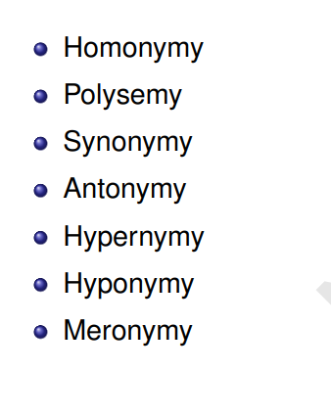
Relations between word meanings

Slide 28
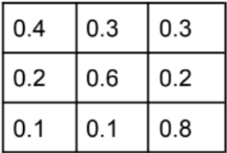
Once a day (e.g. at noon), the weather is observed as one of state 1: rainy, state 2:cloudy, state 3: sunny. The state transition probabilities are :
Given that the weather on day 1 (t = 1) is sunny (state 3), what is the probability that the weather for the next 7 days will be “sun-sun-rain-rain-sun-cloudy-sun”?
a. 1.54 * 10-4
b. 8.9 * 10-2
c. 7.1 * 10-7
d. 2.5 * 10-10

Slide 29
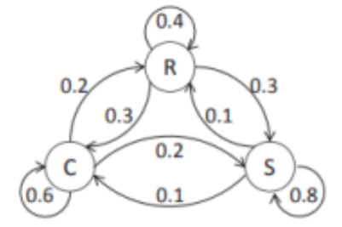
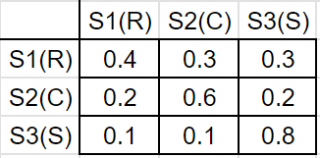
Solution
State 1(S1) = rainy, State 2(S2) = cloudy, State 3(S3): sunny
Given: Weather on day 1 (t = 1) is sunny (state 3).
Therefore, P(S3|start) = 1, P(S1|start) = 0, P(S2|start) = 0
O = {sun, sun, sun, rainy, rainy, sun, cloudy, sun}
O = {S3, S3, S3, S1, S1, S3, S2, S3}

Slide 30
Solution
O = {S3, S3, S3, S1, S1, S3, S2, S3}
P(O | Model)
= P(S3, S3, S3, S1, S1, S3, S2, S3 | Model)
= P(S3|start) P(S3|S3) P(S3|S3) P(S1|S3) P(S1|S1) P(S3|S1) P(S2| S3) P(S3|S2)
= (1)(0.8)(0.8)(0.1)(0.4)(0.3)(0.1)(0.2)
= 1.536 × 10-4
Answer: A

Slide 31
Advanced smoothing algorithms
Good-Turing
Kneser-Ney

